Slide 1
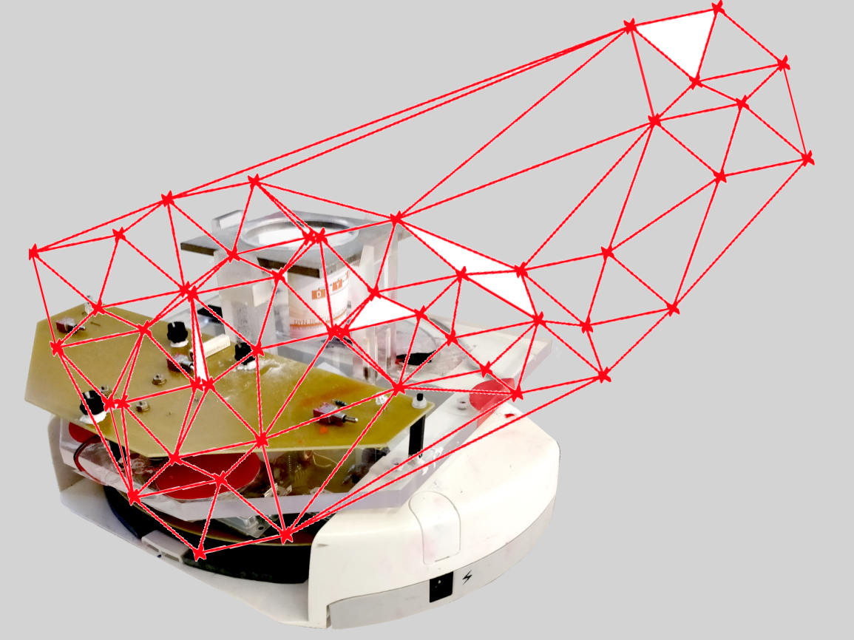
Project group SS18
Development of local positioning system for a pipe-less plant
Team Members: Abdulrahman Abouelkhair, Medhini Rajagopal Balamurugan, Stefan Rottstegge, Stephan Vette
Supervised by : M.Sc.Marina Rantanen Modéer, M.Sc. Afaq Ahmad
Examined by : Prof. Dr.-Ing. Sebastian Engell

Slide 2




Team & Organisation
Stefan Rottstegge
Software
Abdulrahman Abouelkhair
Communication Software
Hardware Setup
Ordering Components
Stephan Vette
Project Leader
Simulation
Ordering Components
Medhini Rajagopal Balamurgan
Existing setup
Communication Software

Slide 3
Agenda
Introduction
Motivation and Objective
Workflow and selection process
Radio-frequency identification
Simulation
Implementation
Demonstration
Conclusions and future work

Slide 4
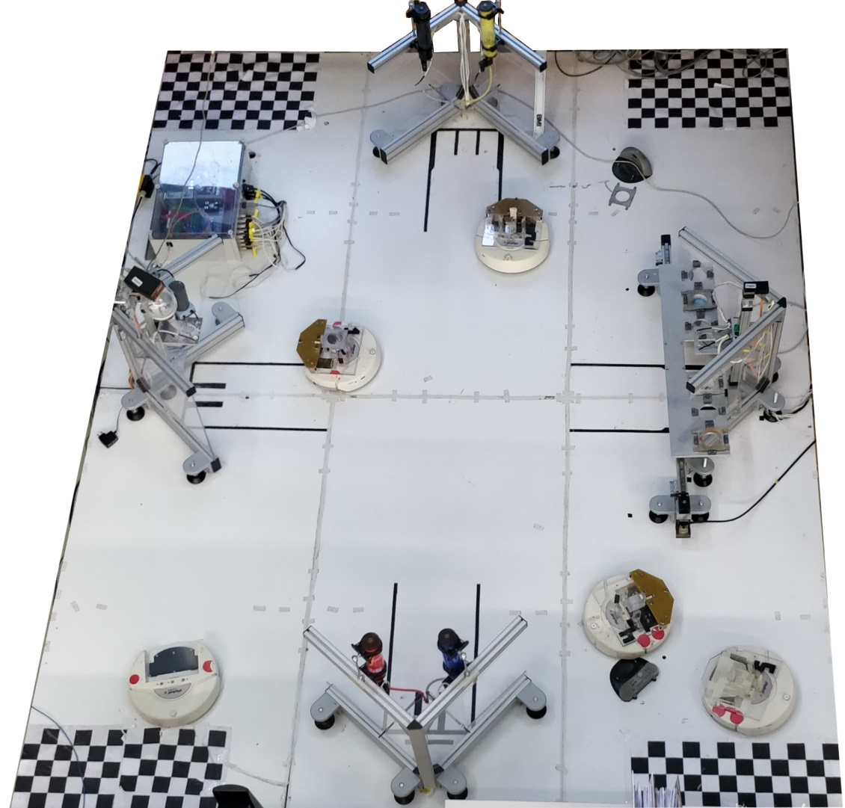
DYN Miniature Pipeless plant
General setup[3x4m]
4 AGVs
2 Color Stations
1 Mixing Station
1 Storage Station
Localization
1 Camera
LED pattern on AGV
Notes:
+ 1 slide camera ..+positoning system

Slide 5
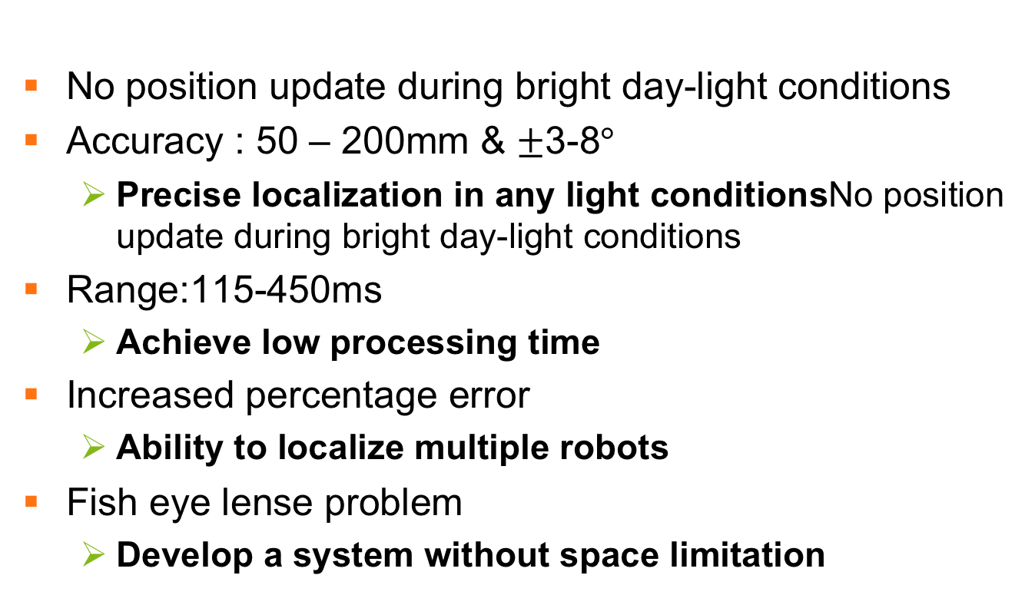
Project motivation
No position update during bright day-light conditions
Accuracy : 50 – 200mm & $±$3-8$°$
Precise localization in any light conditionsNo position update during bright day-light conditions
Range:115-450ms
Achieve low processing time
Increased percentage error
Ability to localize multiple robots
Fish eye lense problem
Develop a system without space limitation
Notes:
Working in all conditions

Slide 6
Project objective
Research about alternative positioning system
Evaluate with simulation
Ultimate goal: improve positioning precision
Compare and develop practical proof of concept

Slide 7
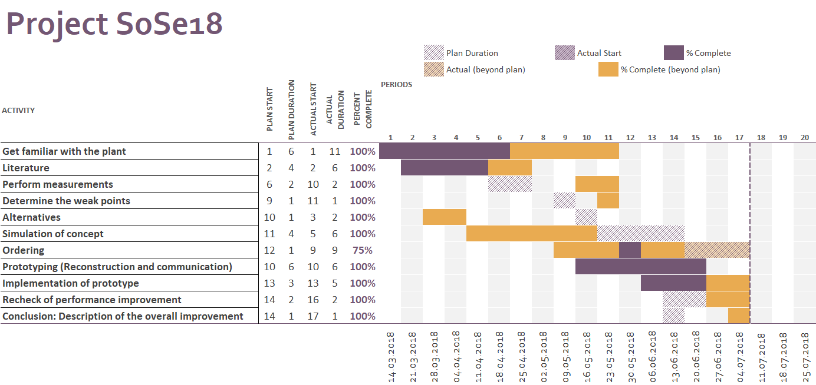
Project Workflow

Slide 8
Selection Process
Triangulation Method
Light dependant
Limited space
Pattern Recognition
Complex and cost intensive
Map-Based Localization
Drawbacks of multiple ultrasonic sensors
Radio-frequency identification
Light independent
Not space limited
Common concept of indoor localization

Slide 9
RFID (Radio Frequency Identification)
Radio Waves
Object
Reader
RFID Tag
Notes:
After in depth analysis of various localization methods we ended up choosing the radio freq. idinit due to its various advantages as discussed earlier
This technology involves a reader and a tag which placed on the object needed to be tracked.
the reader is continuously sending the radio waves, and when the tag is with in the range, its sends a feedback signal to the reader. And the reader can track multiple objects at the same time

Slide 10
RFID System
RFID
Tags
Active
Passive
Reader
Semi-Passive
Notes:
Regarding the tags it can be either
Active: which has its own power supply,
Or passive: which relies on the radio waves which come from the reader as a source of energy,
Or semi: which has power supply but for transmitting the feedback signal it relies on the signal coming from reader.
Question?: So the rate of passive is less

Slide 11
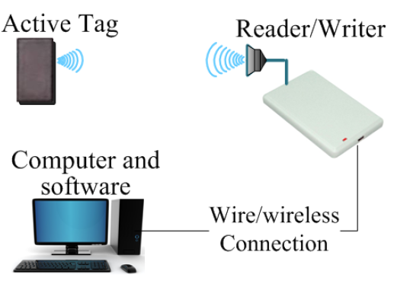
Plant Setup & Implementation
Active
systems reading range is longer
System 1
Multiple readers
1 active tag on robot
Notes:
Now For a plant setup based on active tags, the reader would be sending the feedback info obtained from the tag to a pc or software via wire/wireless connection.(Click) Based on the range Multiple readers have to be installed surrounding our plant while an active tag has to be on the robot.

Slide 12
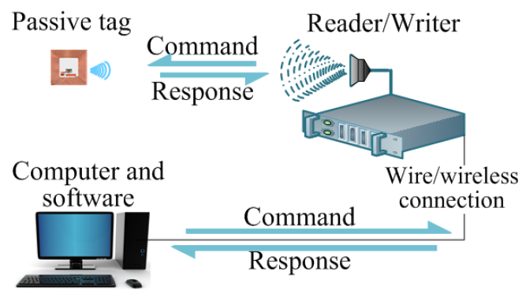
Plant Setup & Implementation
Passive
Power for the passive tag is provided by the reader
System 2
- 1 reader at robot
- many passive tags
Notes:
coming to the plant setup involving passive tags,(Click) one single reader would be placed on the robot while multiple tags would be installed at known locations on the plant floor
Due to the fact that this type of setup has less power consumption, less computational efforts for localization, and less cost, we ended up choosing this setup

Slide 13
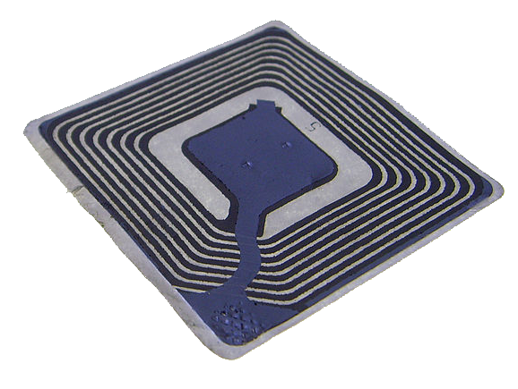
RFID Tags
Passive tag:
Paper type
Cheapest 0.18€
Does not require power supply
Compact
Frequency of Operation:
125 kHz to 135 kHz
Range: 10 cm
Working Principle:
Inductive coupling (Near field coupling)
Notes:
The Passive rfid tag which we use is of paper type with the cheapest cost of 18 cents/per tag. and works based on inductive coupling. Each tag contains a unique identification number and It has a range of 10 cm

Slide 14
RFID Reader - Working Principle
RFID Signal Generator
Microcontroller
Receiver / Signal Detector
Notes:
Moving on to the working of the reader, it consists of 3 main parts
- (click) Generator: which generates the radio waves.
(Click) A signal detect: which receives the feedback signal from the tag
And a microcontroller to process the information from the generator and the detector

Slide 15
RFID Tag - Working Principle
Memory
Controller
Rectifier Circuit
Transponder
Notes:
Regarding the structure of the tag, it consists of:
A Transponder: (click) that receives radio waves and (Click) sends the feedback
And a rectifier circuit which stores the energy coming from the wave across the capacitor, and this energy is used as a power supply for the controller as well as the memory

Slide 16
Inductive coupling (Near field coupling)
Rectifier
RFID Reader
Power
Load
Clock
Controller
Notes:
as discussed earlier The RFID is continuously sending radio waves with particular frequency,
In this case the reader and the tag should be close to each other. (Click Here) the field which is generated by the reader is used to be coupled with antenna of the tag, and bec of this mutual coupling, the voltage is induced across the coil of tag. this voltage is rectified and used as power supply for the controller.
this voltage across the coil with particular frequency, is used to derive synchronization clock for the controller.

Slide 17
Robot Hardware Setup
Sensors and Actuators
Controller
Serial Communication
WiFi module
Robot
Notes:
Moving on to the hardware, I would like to start with the robot current setup
- The in built Microcontroller on the robot receives the sensors data and sends commands to the actuators via serial communication.
- While it sends the sensor data and receive commands from the PC via WiFi module
- For less complexity and more flexibility......
Question?
(RX,TX) is the process of sending and propagating an analogue or digital information signal over a physical point-to-point (wired connection)

Slide 18
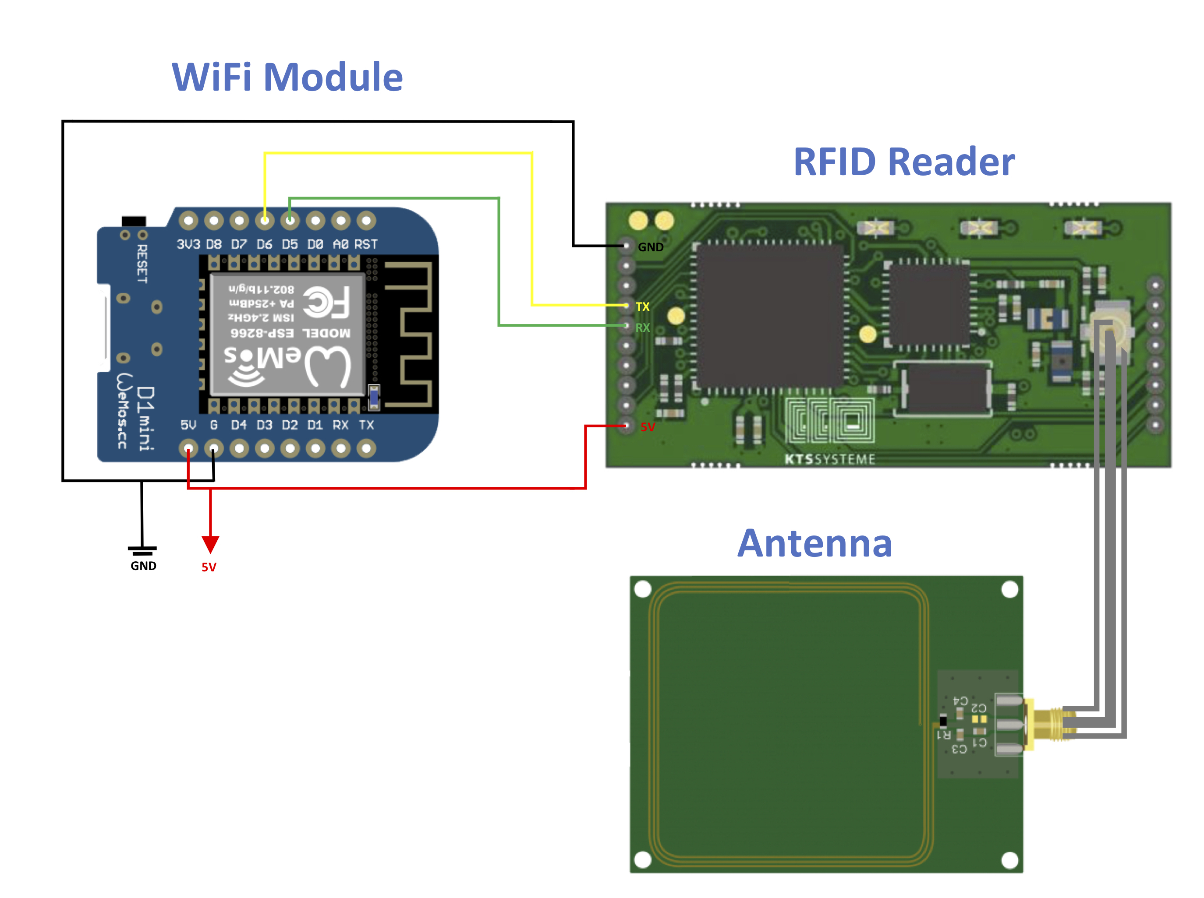
Developed Setup
TX
RX
Antenna
Cable
Antenna
Serial Communication between WiFi Module and RFID Reader
TX/RX
WiFi TCP-IP communication
Notes:
-We developed a new communication setup for the rfid to send the data from the robot to the pc in parallel to the robot setup which we saw in the previous slid.
- It contains the antenna which sends and receives the radio waves and is connected to the RFID reader via SMA cable
- While the RFID sends the read data directly to the built-in microcontroller of wifi module via serial communication
- This WiFi module sends the received data through the network
(RX,TX) is the process of sending and propagating an analogue or digital information signal over a physical point-to-point (wired connection)

Slide 19
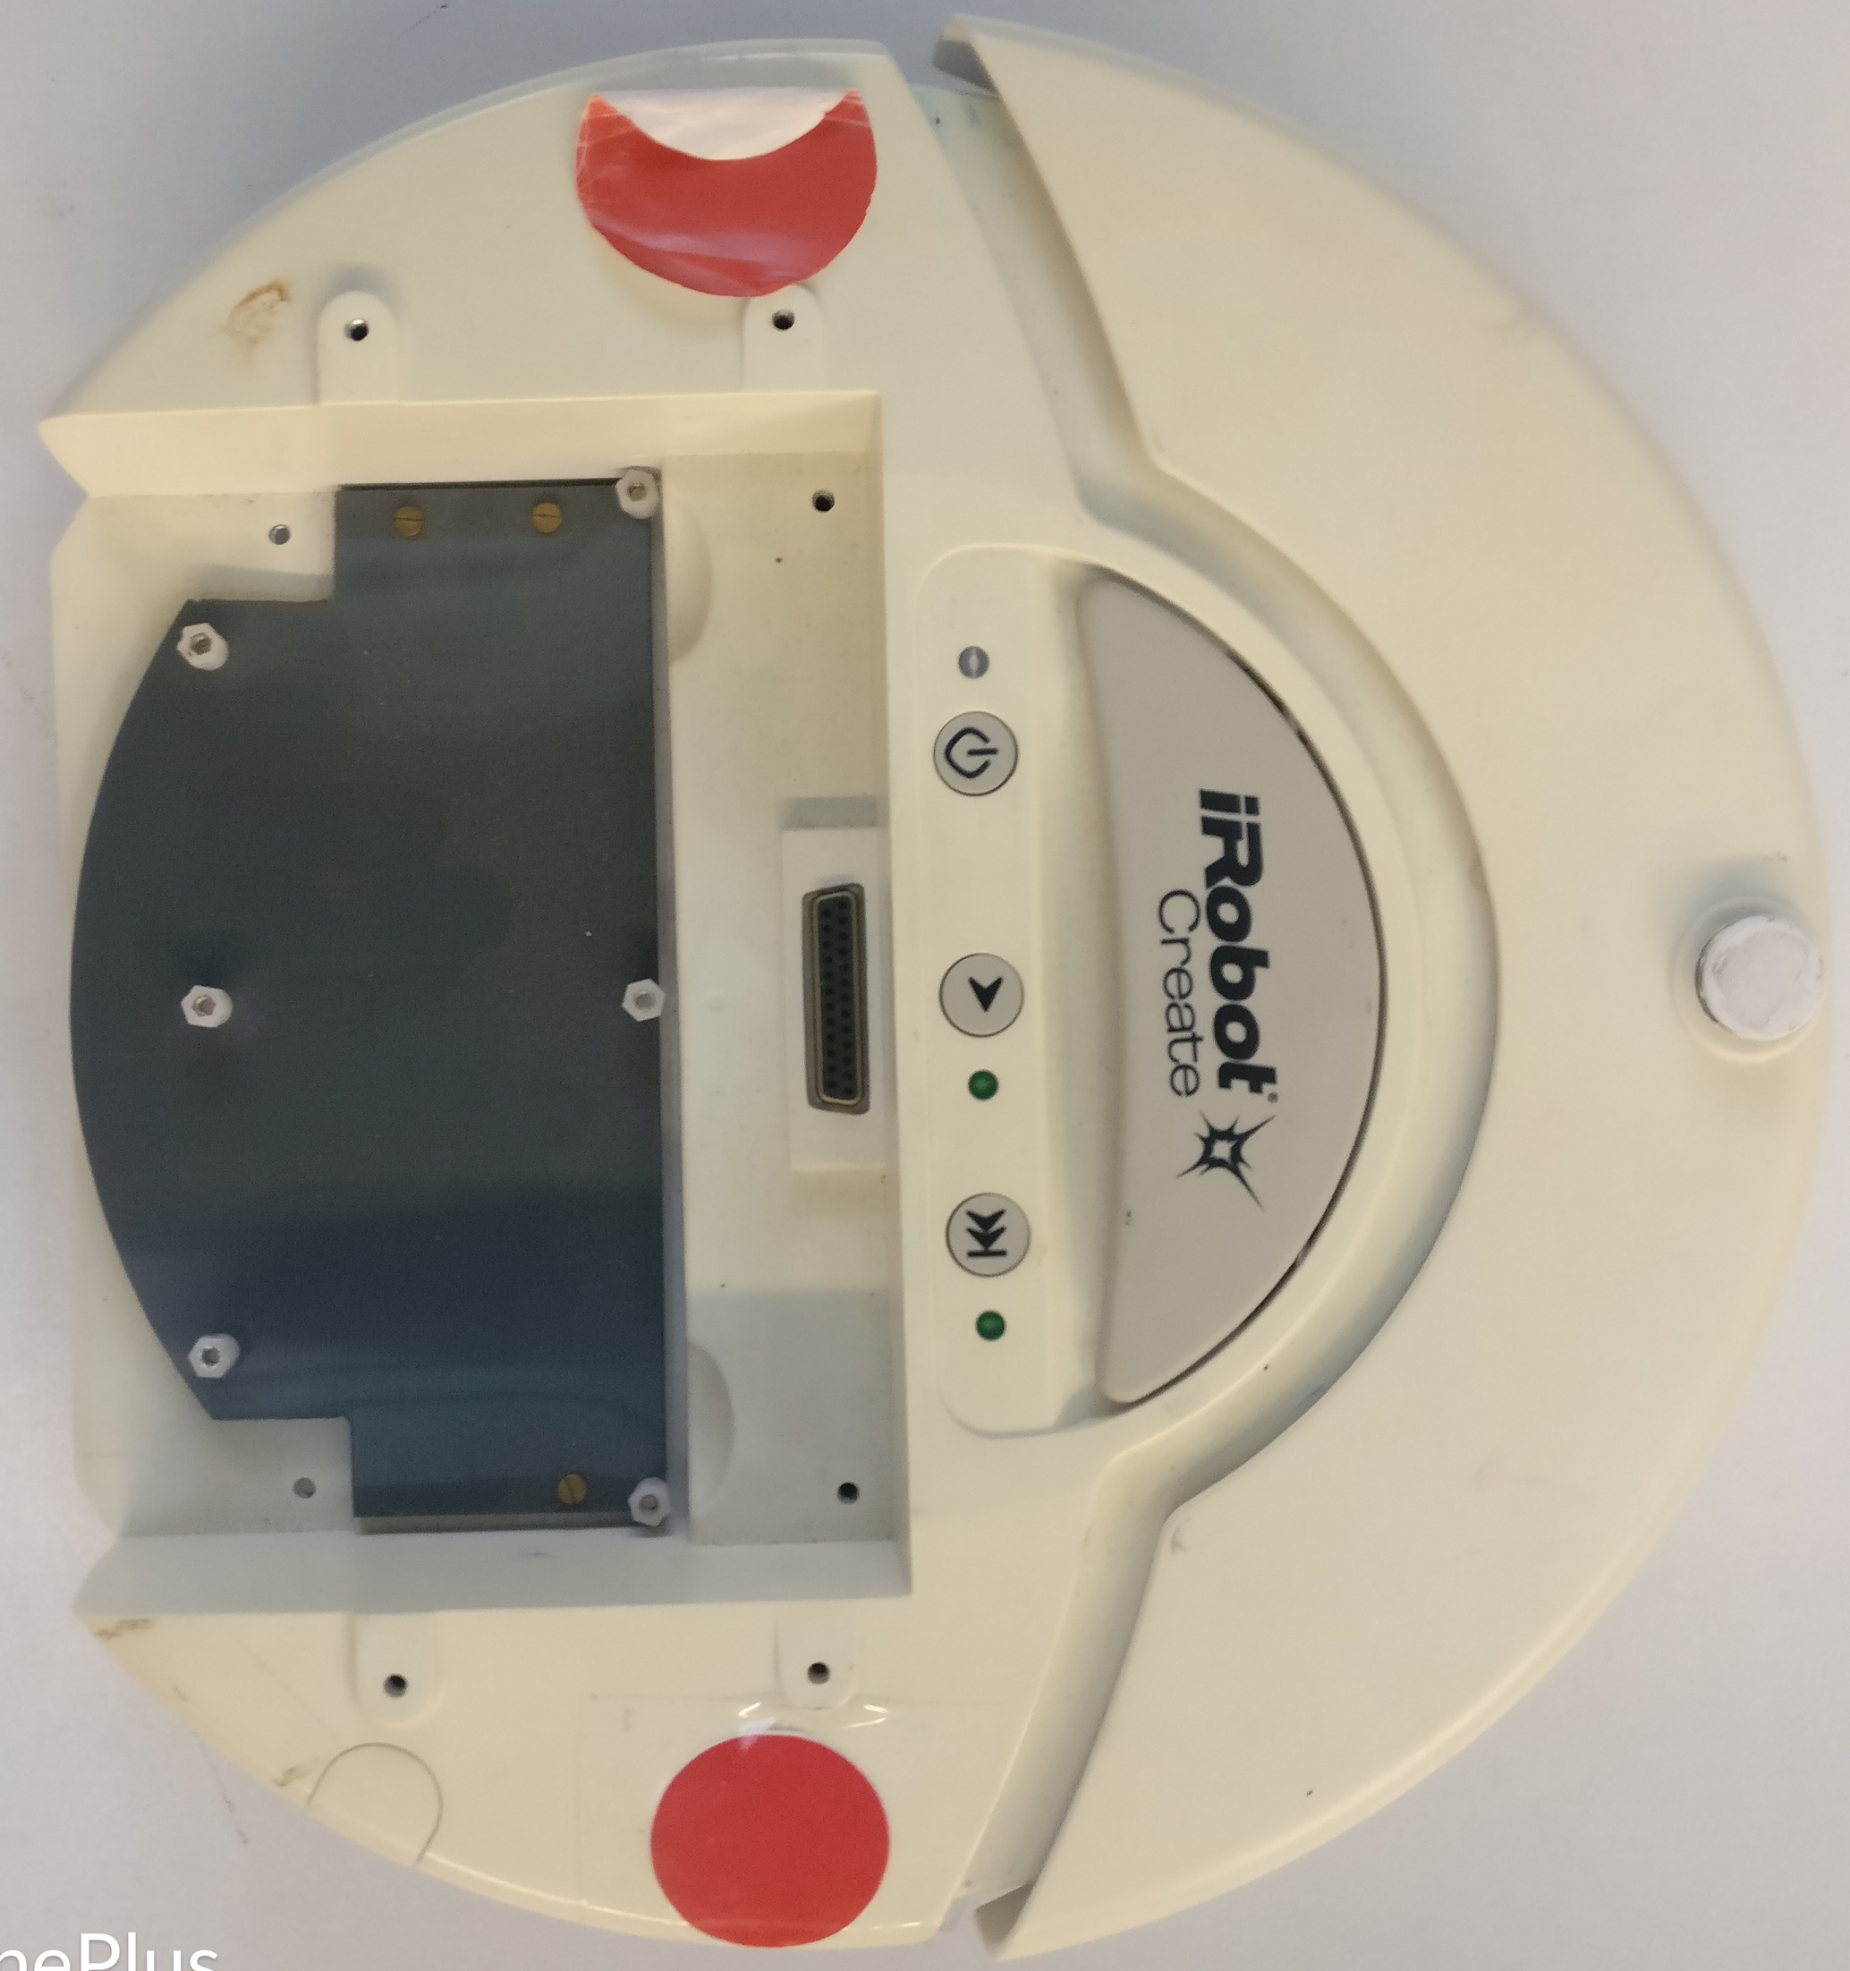
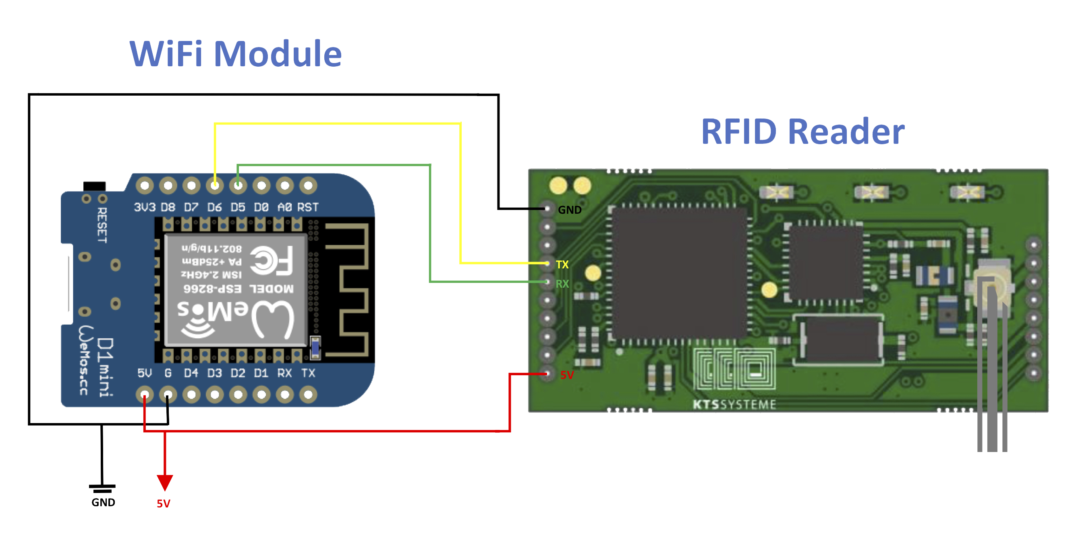
Hardware Setup
Notes:
as we can see here the RIFD reader and the WiFi module are placed on the top of the robot

Slide 20
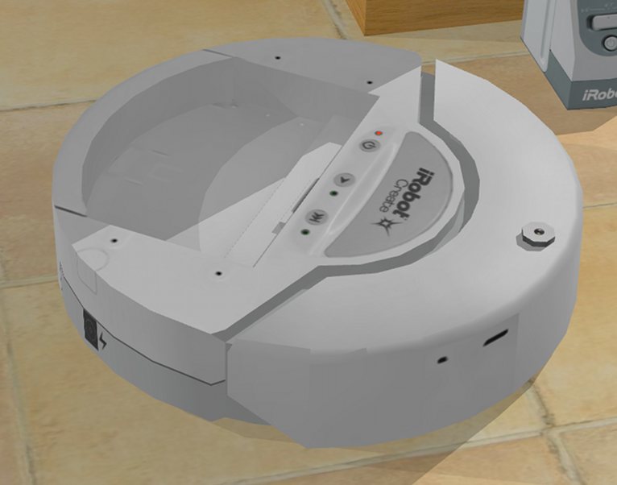
Hardware Setup

Slide 21
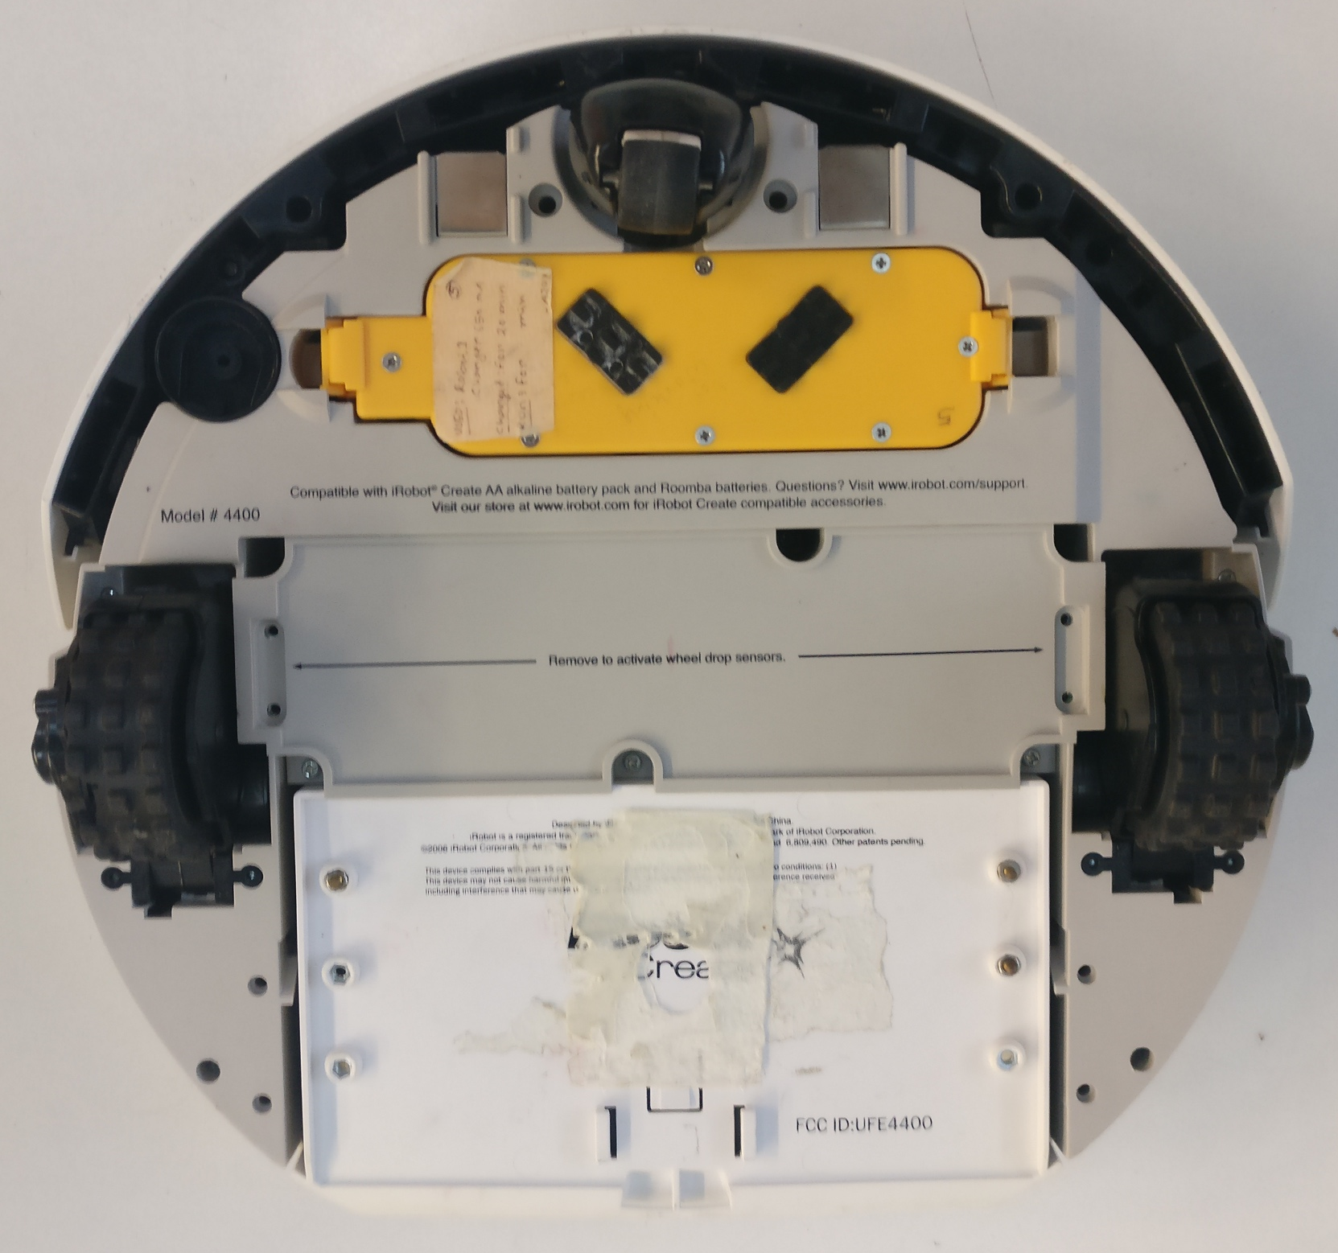
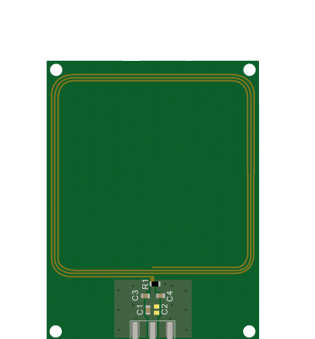
Hardware Setup
Forward
Antenna
Notes:
While the antenna is fixed to the base,.. so the radio waves would be in direct contact with the tags on the floor.

Slide 22





Communication Software
Network
Receiving
Shared
Data
Arduino
Visual Studio
WiFi Module
Serial Communication
RFID Reader
Notes:
Finally on the side of the communication software.
We had overwritten on the built-in microcontroller of the Wifi Module a software which we developed (Click) to have a continuous listening to all the data which been sent from the RFID reader even if there are no tags within the range.
(Click) a TCP-IP communication is stablished within the network on the WiFi module that start publishing all the data which has been received from the reader, and this communication is killed only during the robot shutdown.
(Click) While on the other side on PC (GUI) we have established the same type of communication which should be in same network, and and should keep listening to this particular WiFi module even if it sends nothing, this communication can be stopped from the GUI if needed
Moving on to the simulation it would be discussed by my college stephan
Question? TCP/IP stands for “Transmission Control Protocol / Internet Protocol”. It is basically a network protocol that defines the details of how data is sent and received through network adapters, hubs, switches, routers and other network communications hardware.

Slide 23
Simulation + Emulator
Emulator to create artificial RFID reader data
Answer design questions in validation (model based)
Parameter:
Size plant [1x1m]
Robot position + properties
Reading ranges [0-10cm]
Distance between the tags [10cm]
Number of measurements for each 360°turn (Init Proc)
Output: (txt file)
Measurement direction of robot
Detected unique identification (UIDs)
Related received signal strength indicator (RSSI) [0...7]

Slide 24
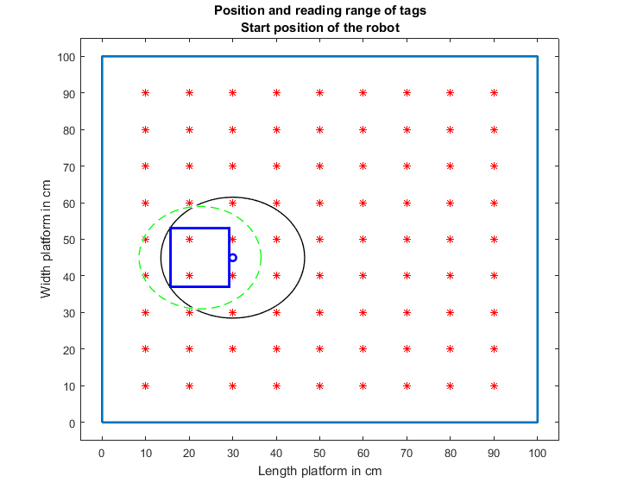
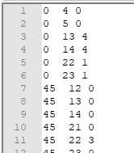
Emulator
Direction [˚]
UID
RSSI
Robot center o , dimension o
Position of the antenna ,Tags *
Max reading range of the antenna --

Slide 25
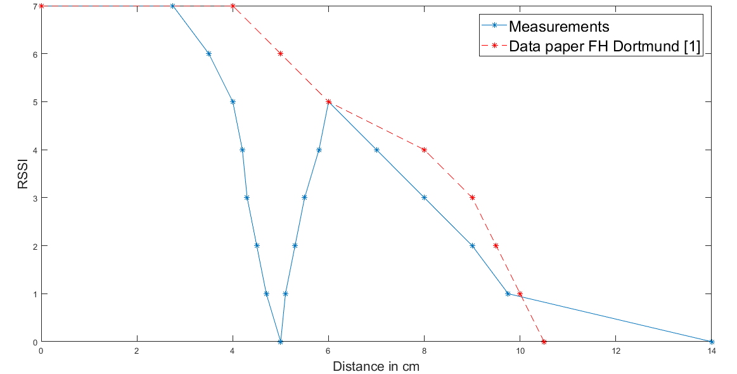
Simulation update
Measurements: inconsistency in RSSI and distance between tag and reader
[1] RFID-Based Localization of Mobile Robots, Christof Röhrig, Daniel Heß and Frank Künemund, FH Dortmund
Notes:
Order. circle

Slide 26
Possible reasons blind spot
The field and the inductor of the tag are perpendicular
Antenna
1.5 cm
Tag

Slide 27
Simulation results with emulated data
Used the code to estimate the initial position and orientation with the emulated data
Without inconsistence (data from paper):
Error in X,Y-Position: 2 mm
Error in orientation: < 1°
After the update (with blind spot):
Error in X, Y-Position: 10 mm
Error in orientation: 20°

Slide 28



Software Implementation
Reader
WiFi-Module
Receiving()
RX
TX
TX
RX
C#
Initialization()
C#
MPC()
Position()
Orientation()
C#

Slide 29
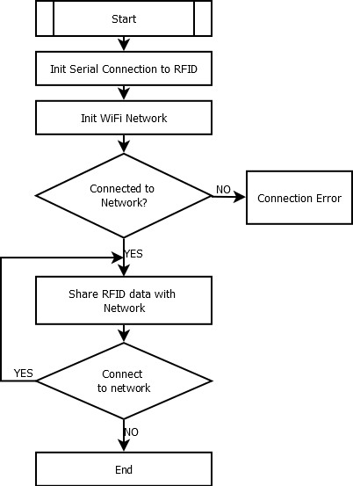
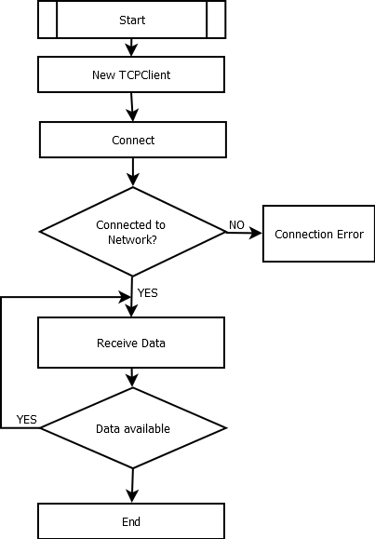
Transmitting Receiving

Slide 30
Software Implementation
SCAN:+UID=xxxxxxxxxxxxxxxx,+RSSI=x/x
Reader
WiFi-Module
Receiving()
RX
TX
TX
RX
C#
Initialization()
C#
MPC()
Position()
Orientation()
C#

Slide 31
Data Processing
Received Data via. WiFi
Filter bad readings by “-”
Split string at “OK”, ”\r”, “\n”, “SCAN+UID=“, “RSSI=“
Convert UID from hex to dec and separate from RSSI
SCAN:+UID=E00401503A5BD691,+RSSI=0/0
SCAN:-UID=E00401503A5BDAE4
SCAN:+UID=E00401503A5BD691,+RSSI=0/0
E00401503A5BD691 0/0
1681 0/0

Slide 32
Software Implementation
SCAN:+UID=E00401503A5BD691,+RSSI=0/0
Reader
WiFi-Module
Receiving()
RX
TX
TX
RX
C#
1681 0/0
Initialization()
C#
MPC()
Position()
Orientation()
C#

Slide 33
Initialization()
Why is a Initialization necessary?
Initialization procedure

Slide 34

Why is an Initialization necessary?

Slide 35
Why a 360°turn?

Slide 36
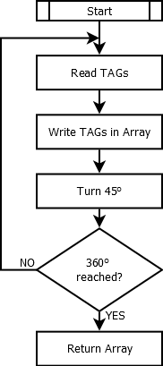
Initialization Procedure
 | ID1 | ID2 | ID3 | ID4 | ID5 | ID6 | ID7 | ST1 | ST2 | ST3 | ST4 | ST5 | ST6 | ST7
0° | 4 | 1 | 5 | 2 | 3 |  |  | 0 | 0 | 1 | 7 | 0
45° | 5 | 3 |  |  |  |  |  | 2 | 3
90° | 3 | 5 |  |  |  |  |  | 2 | 2
135° | 9 | 8 | 6 | 5 |  |  |  | 1 | 1 | 1 | 2
180° | 9 | 7 | 8 | 6 | 4 | 5 |  | 2 | 0 | 6 | 0 | 0 | 2
225° | 4 | 7 | 5 | 8 |  |  |  | 0 | 2 | 3 | 3
270° | 5 | 4 | 7 | 8 | 1 |  |  | 2 | 5 | 0 | 0 | 0
315° | 2 | 4 | 1 | 5 |  |  |  | 0 | 2 | 2 | 0

Slide 37
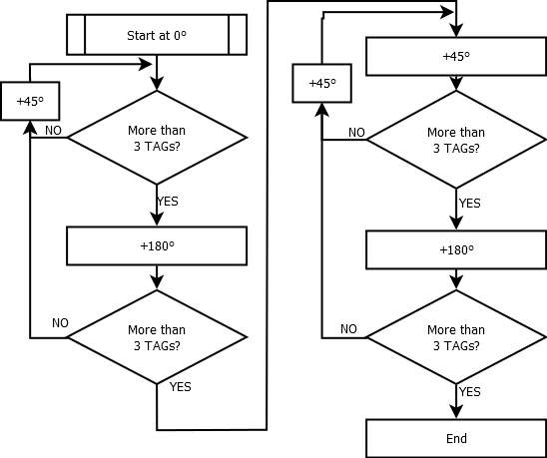
Analyzing Initialization Array[8,14]
ID1 | ID2 | ID3 | ID4 | ID5 | ID6 | ID7 | ST1 | ST2 | ST3 | ST4 | ST5 | ST6 | ST7
4 | 1 | 5 | 2 | 3 |  |  | 0 | 0 | 1 | 7 | 0
5 | 3 |  |  |  |  |  | 2 | 3
3 | 5 |  |  |  |  |  | 2 | 2
9 | 8 | 6 | 5 |  |  |  | 1 | 1 | 1 | 2
9 | 7 | 8 | 6 | 4 | 5 |  | 2 | 0 | 6 | 0 | 0 | 2
4 | 7 | 5 | 8 |  |  |  | 0 | 2 | 3 | 3
5 | 4 | 7 | 8 | 1 |  |  | 2 | 5 | 0 | 0 | 0
2 | 4 | 1 | 5 |  |  |  | 0 | 2 | 2 | 0

Slide 38
Software Implementation
SCAN:+UID=E00401503A5BD691,+RSSI=0/0
Reader
WiFi-Module
Receiving()
RX
TX
TX
RX
C#
1681 0/0
Initialization()
C#
Array[8,14]
MPC()
Position()
Orientation()
C#

Slide 39
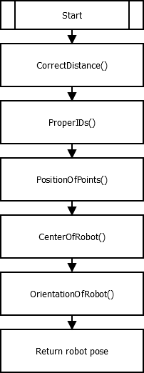
Initial position & orientation
Based on the recorded array
ID1 | ID2 | ID3 | ID4 | ID5 | ID6 | ID7 | ST1 | ST2 | ST3 | ST4 | ST5 | ST6 | ST7
4 | 1 | 5 | 2 | 3 |  |  | 0 | 0 | 1 | 7 | 0
5 | 3 |  |  |  |  |  | 2 | 3
3 | 5 |  |  |  |  |  | 2 | 2
9 | 8 | 6 | 5 |  |  |  | 1 | 1 | 1 | 2
9 | 7 | 8 | 6 | 4 | 5 |  | 2 | 0 | 6 | 0 | 0 | 2
4 | 7 | 5 | 8 |  |  |  | 0 | 2 | 3 | 3
5 | 4 | 7 | 8 | 1 |  |  | 2 | 5 | 0 | 0 | 0
2 | 4 | 1 | 5 |  |  |  | 0 | 2 | 2 | 0

Slide 40
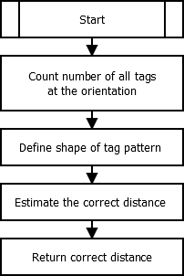
CorrectDistance()
Max
Min
RSSI | 0 | 1 | 2 | 3 | 4 | 5 | 6 | 7
Distance in [cm] | 14 | 9.75 | 9 | 8 | 7 | 6 | 3.5 | 2.75 | Max
Distance in [cm] | 5 | 5.1 | 5.3 | 5.5 | 5.8 | 4 | - | - | Middle
Distance in [cm] | - | 4.7 | 4.5 | 4.3 | 4.2 | - | - | - | Min

Slide 41
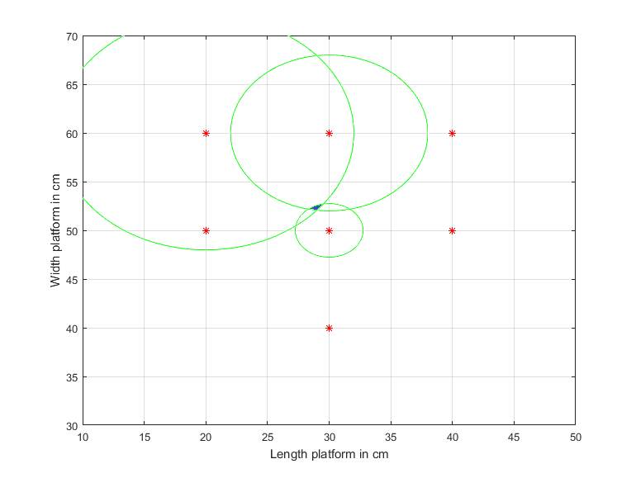
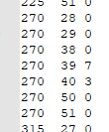
Trilateration
Using 3 defined positions + 3 radii to estimate the intersection point
Example
7 tags found
r₂
r₃
r₁

Slide 42
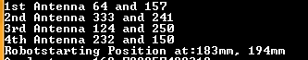
CenterOfRobot()
The intersection can easily be computed with the help of the four coordinates
Output of the console:
1st Antenna
4th Antenna
x₁,y₁
x₈,y₈
x, y
3rd Antenna
x₄,y₄
x₅,y₅
2nd Antenna

Slide 43
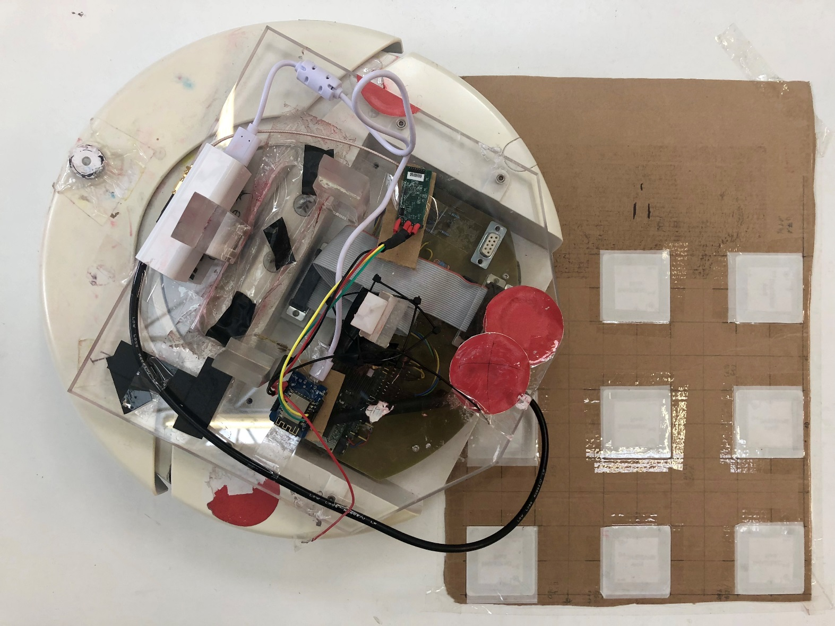
Initialization Procedure

Slide 44


Conclusion
An alternative positioning system was picked
Proof of concept was evaluated
Ultimate goal: Improve positioning precision
Light independent system was created
Highly scalable solution was found
Accuracy under perfect light condition was improved
Old Error: 50mm/3° New Error: 25mm/25°
Accuracy under bad light condition was improved
Old Error: 200mm/8°New Error: 25mm/25°
Processing time was improved
Old time: 100-400ms New Time: min 90ms
Notes:
Include data abt the accuracy !!

Slide 45
Future Work
Hardware
Use local power supply of the robot
Include 15V to 5V converter
Add more the TAGs on an extended plant model
Add RFID modules to all robots
Software
Initialization turn based on more accurate parameter than time.
Encoders of the robot
Delete unused camera modules in the code
Optimize the localization algorithm

Slide 46
Thank you for your attention!

Slide 47
Inductive coupling (Near field coupling)
Rectifier
RFID Reader
Power
Load
Clock
Controller
Notes:
So in this case the reader and tag are so close to each other. (Click Here) So the field which is generated by the reader used to be coupled with antenna of the tag, and bec of this mutual coupling, the voltage is will be get induce across the coil of tag. Then this voltage is rectified and used as power supply for the controller as well as the memory. Now as the reader is sending waves with frequency, the voltage across the coil is also with particular frequency, which is also used to derive synchronization clock for the controller.
Question?: (load modulation) So if we connect a load of this coil so the current will start flowing through this load. So if switched on and off of this load, the current will also get switched on and off, so this switching on and off called load modulation. and if switched on and off of this load according to the data which is been stored in the tag then the data can be read by the reader in form of voltage, so using the load modulation we r changing the voltage which is been generated across the reader coil. Generating modulation an carrier frequancy

Slide 48
WiFi Module and RFID
Start
Initiate Connection (115200 Baud Rate)
(Good Readings) SCAN: +UID = XXXXX, +RSSI = ¾
(Bad Readings) SCAN: - UID = XXXXX, +RSSI = ¾
Comigrate Type of RFID Scan
Scan Type Correct?
NO
Error Scan
YES
OK received
Arduino
Received Readings
NO
Create Empty
Scan
WiFi Module
YES
UART
SCAN: +/-UID = XXXXX, +RSSI = 3/4
Module Shutdown?
RFID Reader
NO
YES
End

Slide 49
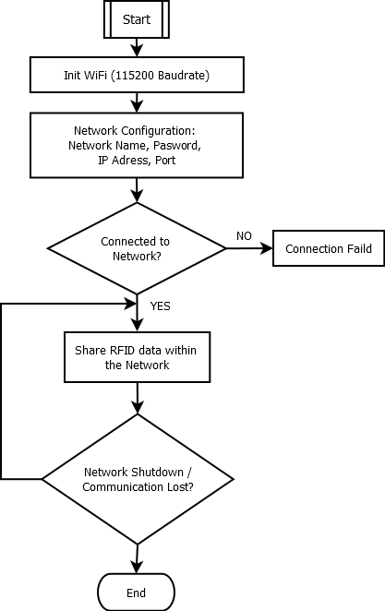
WiFi Module To the Network
Network
Arduino
WiFi Module
UART
RFID Reader

Slide 50
PC receiving from the network
Start
Config. IP Address & Port of Server
Network
Server
Connection
Established?
NO
Connect Failed
Receiving
Shared
Data
YES
Keep Listening to the server
Visual Studio
Arduino
Save Shared data in a String
WiFi Module
NO
Network
Shutdown?
UART
SCAN:+UID=E00401503A5BD691,+RSSI=0/0
YES
End
RFID Reader

